Slide 1
Information Literacy
Web Evaluation
University of South Dakota Library. University of South Dakota, 2013. Web. 01 Oct. 2013.

Slide 2
Why is web evaluation important?
There are 3 reasons why it is important for you to understand how to evaluate web resources…
By learning how to evaluate web resources, you will be able to distinguish reliable/credible resources from ones that are not – You will be able to find the best sources for your paper.
By analyzing how the Internet works, you will have a better understanding of it and you will develop your research skills.
Most importantly, these skills will benefit you as you go on to pursue your content specific career goals.

Slide 3

What is the Web?
Hint: it has nothing to do with Spider-Man.
The web is an interconnected global Internet service that provides hypertext data and resources to viewers.
This information is viewed through a browser (safari, Internet Explorer, Firefox…)

Slide 4

What are the main functions of the web?
The main functions of the web are…
Information sharing
Education
Commerce
Entertainment
Communication

Slide 5
Internet facts
There are 50,000,000 new Internet users in the U.S. each month.
Young adults with more education use the Internet more often.
Attending school/college – 85%
Not attending school/college – 51.5%
Of adults using the Internet at home…
88% use email
64% do research
Source: U.S. Census Bureau. Home Computers and Internet Use in the United States: August 2000. Washington, DC: U.S. Census Bureau, 2001.
Source: Kemp, Simon. “The Global State of the Internet in April 2017.” thenextweb.com TNW. Apr 2017. Web. 28 Jul. 2017.

Slide 6
More facts
More than 7.5 million new pages go onto the Web every day.
The Web contains an estimated 2.5 billion documents.
The average life span of a URL (i.e. Web address) is 100 days.*
There are more than 2,500 search engines/directories on the Internet.*
The largest search engine (AltaVista) has access to between 14%-16% of the URLs at any one time.
The largest domain is .com, comprising 35.3% of all Internet hosts.
Not everything in print is available online, especially if it was created before 1990.
Source: Lafrance, Adrienne. “How Many Websites Are There?” theatlantic.com The Atlantic Monthly Group. 30 Sept. 2015. Web. 28 Jul. 2017.

Slide 7
Why teachers nag you about Internet sources
Book sources & Articles: These are sources that are subject to review by editors, publishers, and experts. They are often times printed or published by a magazine or company that has a reputation to uphold. With that being said, the publishers and editors do not just let anything get published.
Internet sources: Everyone and no one is in charge. The sources posted on the Internet have no filter and do not need to meet a certain caliber to be published. Because of this, information can easily be manipulated and is therefore seen as not reliable or credible.

Slide 8
5 things to remember about search engines
They are listings of what is available on the Web.
Each search engine accesses only a portion of what is available from the Web.
Search engines provide different search features.
They do not guarantee the quality (or truth) of information contained in Web sites.
Search engines that rank Web sites generally do so on the basis of other criteria than quality.
Software can't currently be programmed to recognize quality of information. Search engines rely on indirect indicators of quality.

Slide 9
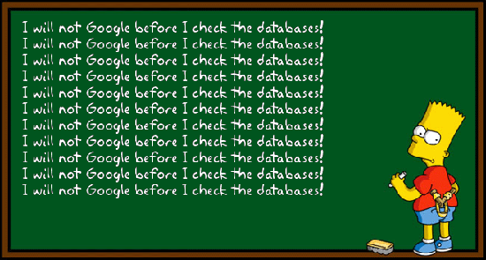
When approaching web sources…
Be critical: There are few/no selection criteria for the Web.
Be skeptical: Some Web authors are honest, others are ignorant or misguided, some are just plain dishonest.
Know what to look for when evaluating Web sites.
Be visually literate.

Slide 10
Criteria for evaluating a web source
Origin (author, webmaster, or publisher): Are they an expert? Is there an agenda?
Authority: Is the author biased? Who is the publisher? (.com, .org, .gov, .edu…)
Purpose: Is there a clear audience?
Objectivity or Bias: Are the goals of the author/site clearly stated? Is there any advertising on the page? If so, is it set apart from the page content?

Slide 11
Criteria for evaluating a web source
Accuracy: How accurate is the information? If it fact or opinion? Are there facts or sources to back up the information? Are there grammatical errors?
Relevance: Does the information add anything to your research? Does it hold any merit or importance?
Coverage Currency: To what depth is the content covered? Is the topic clearly stated? How current is the information? When was the site last updated?

